Slide 1
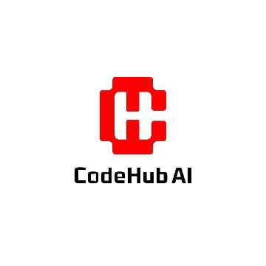
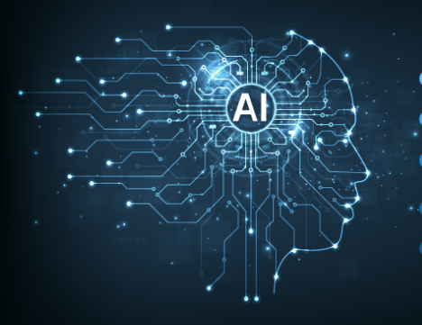
Generative AI
Full Stack Developer

Slide 2
Course D : Agentic AI

Slide 3
05
Model Context Protocol (MCP)
Connecting AI to the Real World
Standardizing the Missing Layer Between AI and Action

Slide 4
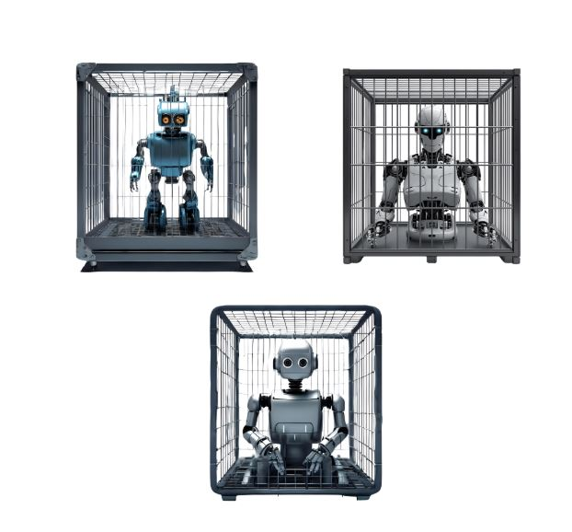
The Challenge: AI in Isolation
The "Brilliant AI Assistant" Dilemma
Imagine a brilliant AI assistant that can code, analyze data, and support customers.
The Isolation Chamber
But it is locked in a room! It has no direct access to your tools, files, or databases.
Manual Handover
The AI must manually hand over everything. This is the reality for most LLMs today.

Slide 5
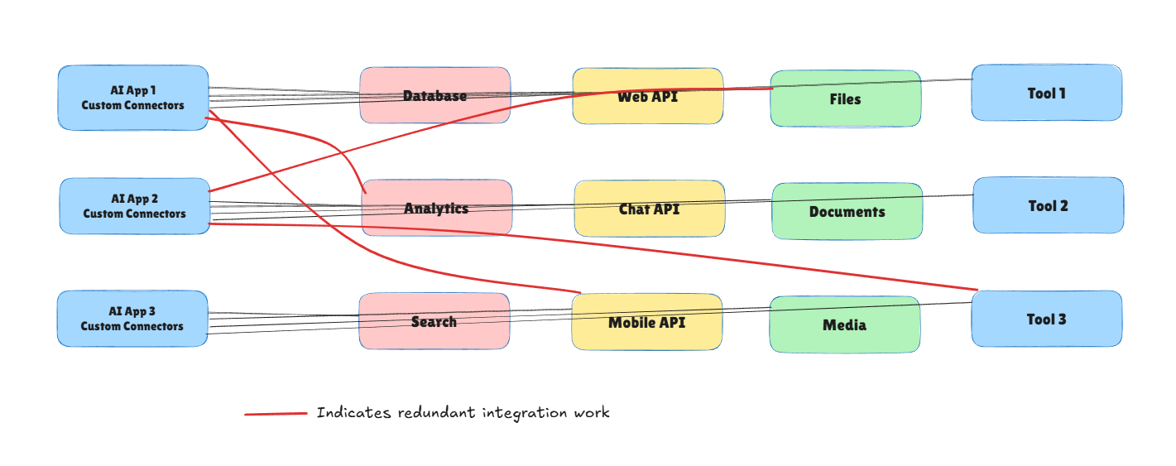
Pain Points of Integration: Fragmentation

Slide 6
Pain Points of Integration: Fragmentation
Bespoke Development
Techniques like RAG and agent frameworks exist, but every integration is bespoke—it requires custom code.
Custom Needs Per App
This results in repeated effort for: custom prompt logic, custom tool calls, and custom data access.
Redundant Work
Every application creates its own custom wrappers for APIs, tools, and memory.
Required Extras
This fragmented approach requires special prompts, tool-specific connectors, and redundant safety checks.

Slide 7
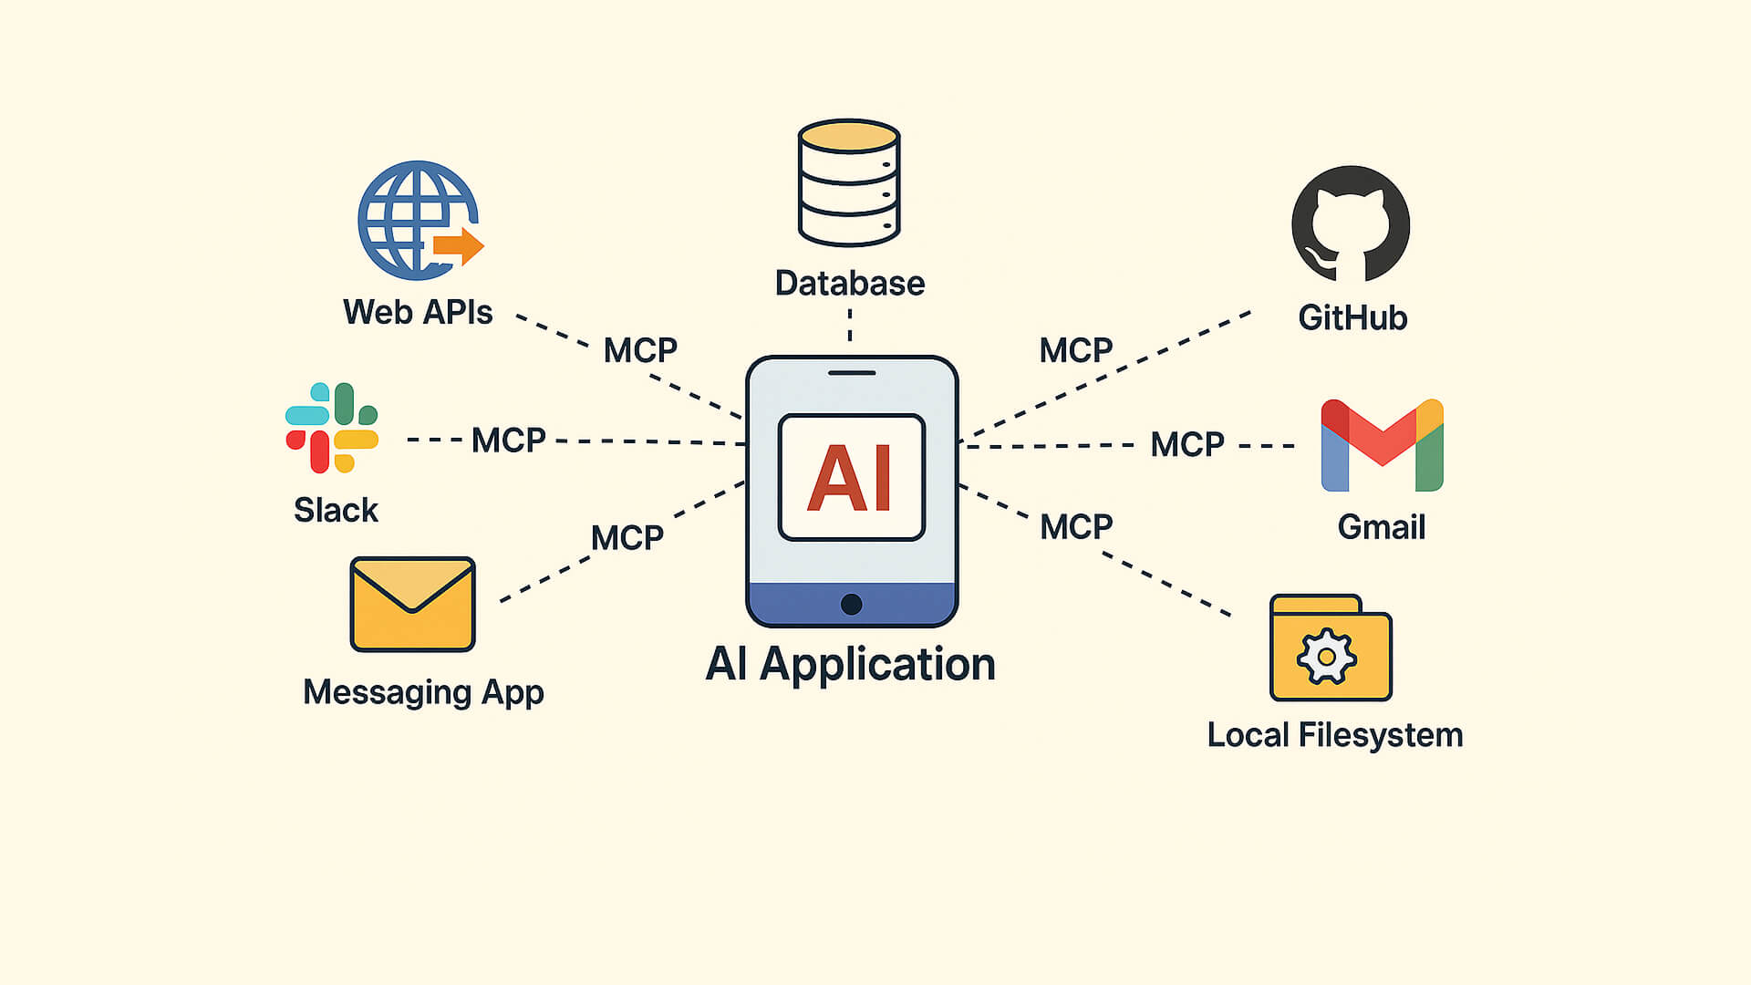
Model Context Protocol : MCP

Slide 8


What is the Model Context Protocol (MCP)?
MCP is an open protocol that standardizes how your LLM applications connect to and work with your tools and data sources.
The goal is to create a common way for AI applications to use tools, memory, and agents.
MCP unifies access to resources and actions across various services and data sources.
MCP is neither a framework nor a tool—it's a protocol, similar to HTTP for the web or SMTP for
email.
MCP is a new standard redefining how LLMs interact with tools, memory, and agents.

Slide 9
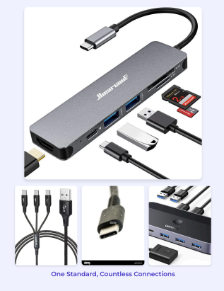
MCP: The Standardized Connection
USB-C for AI
MCP is like a USB-C port for AI applications. Just as USB-C provides a standard way to connect various devices (phones, laptops) to peripherals (chargers, monitors), MCP provides a standard protocol for AI models to connect to various data sources and tools.
HTTP for Agents
Just as HTTP enables any browser to communicate with any website, MCP allows any AI agent to interact with any tool or service (e.g., GitHub, Slack, Databases, Web APIs).

Slide 10

MCP vs. Traditional APIs
A Quick Comparison
Feature | MCP | Traditional API
Integration Effort | Single, standardized integration. | Separate integration per API.
Dynamic Discovery | Yes. | No.
Scalability | Easy (plug-and-play). | Requires additional integrations.
Security & Control | Consistent across tools. | Varies by API.
When to Stick with APIs
Traditional APIs are preferable when fine-grained control, highly-specific restricted functionalities, or maximum predictability with minimal context autonomy are needed.

Slide 11


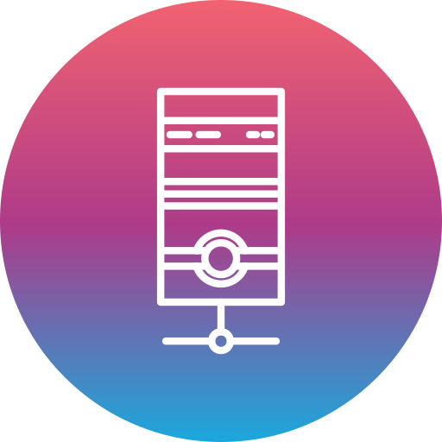
MCP Architecture Overview
Requests
Response
MCP Protocol
Data Results
Data Access
Fetch Execute
MCP Host Ai Application
MCP Client Protocol Translate
MCP Server Capability Adapter
The Model Context Protocol standardizes how all components communicate
MCP Host (AI Application)
The AI-powered app (e.g., chat assistant, IDE extension) that uses an LLM and needs to interact with external data or tools.
MCP Server
A lightweight program that exposes specific data or capabilities via the MCP standard. Acts as an adapter that connects to one data source.
MCP Client
Runs in the AI application and translates AI requests into the standardized protocol format, maintains the connection, and
manages communications.
Data Sources & Services
The actual location of information or functionality: local files, web APIs, databases, and cloud services that the AI needs to access.

Slide 12
Core Concept 1: Resources vs Tools
Understanding the two fundamental ways MCP connects AI to data & actions
Concept | Resources | Tools
Description | Data or content the server provides to the AI. The AI requests it to load information. | Actions the AI can invoke via the server. They execute code or cause a side effect.
Analogy | endpoint in web technology. | endpoint in web technology.
Control Type | Application-Controlled. The app decides what resources are available. | Model-Controlled. The AI decides when to call tools.
Examples | Files, API Responses, Database Records, Context Windows, Documentation | Run calculations, Modify data, Send messages, Query databases, Execute commands

Slide 13
Core Concept 1: Resources vs Tools
Understanding the two fundamental ways MCP connects AI to data & actions
Concept | Resources | Tools
Description | Data or content the server provides to the AI. The AI requests it to load information. | Actions the AI can invoke via the server. They execute code or cause a side effect.
Analogy | GET endpoint in web technology. | POST endpoint in web technology.
Control Type | Application-Controlled. The app decides what resources are available. | Model-Controlled. The AI decides when to call tools.
Examples | Files, API Responses, Database Records, Context Windows, Documentation | Run calculations, Modify data, Send messages, Query databases, Execute commands

Slide 14
Core Concept 2: Prompts and Sampling
Templates and two-way communication
Concept | Description | Control Type | Use Case
Prompts | Reusable prompt templates or workflows supplied by the server. They help guide the AI through complex tasks. | User-Controlled | Documentation Q&A, Transcript Summary
Sampling | An advanced feature where the server can request the AI to complete or transform text. | Two-way communication | The server asks the AI to analyze data it provided.
The Prompts and Sampling features enable MCP to go beyond simple one-way tool calls, allowing for sophisticated interaction patterns between models and servers. This creates a more dynamic collaboration where either side can initiate requests.

Slide 15
How MCP Communicates: Transports
STDIO (Standard Input/Output)
The MCP server runs as a local process on the same machine as the host, communicating through pipes. Client and server exchange JSON messages via stdin and stdout.
Best for: Local development, simple integration, and debugging.
HTTP (SSE - Server-Sent Events)
The MCP server runs as a web service (locally or remotely), exposing an HTTP endpoint. It establishes bidirectional communication over HTTP.
Best for: Hosted servers, distributed architecture, multiple concurrent
clients.
Security Note
MCP emphasizes security controls, as servers access sensitive data; the AI host often requires user approval before executing a tool.
STDIO Transport
AI Host
MCP Server
Local process, JSON via stdin/stdout
HTTP/SSE Transport
AI Client
Web Server
Remote connection, bidirectional via HTTP

Slide 16

Why MCP is a Game-Changer: Standardization
Provides one common interface for databases, APIs, and file systems
Efficiency: Eliminates the need for custom code per tool
Reduced overhead: Speeds up development and reduces maintenance.
Write once, integrate multiple times: Simplified development allows you to integrate multiple times without rewriting custom code for every integration
Standardization leads to simpler, more scalable integrations between AI and the tools it needs to access.

Slide 17
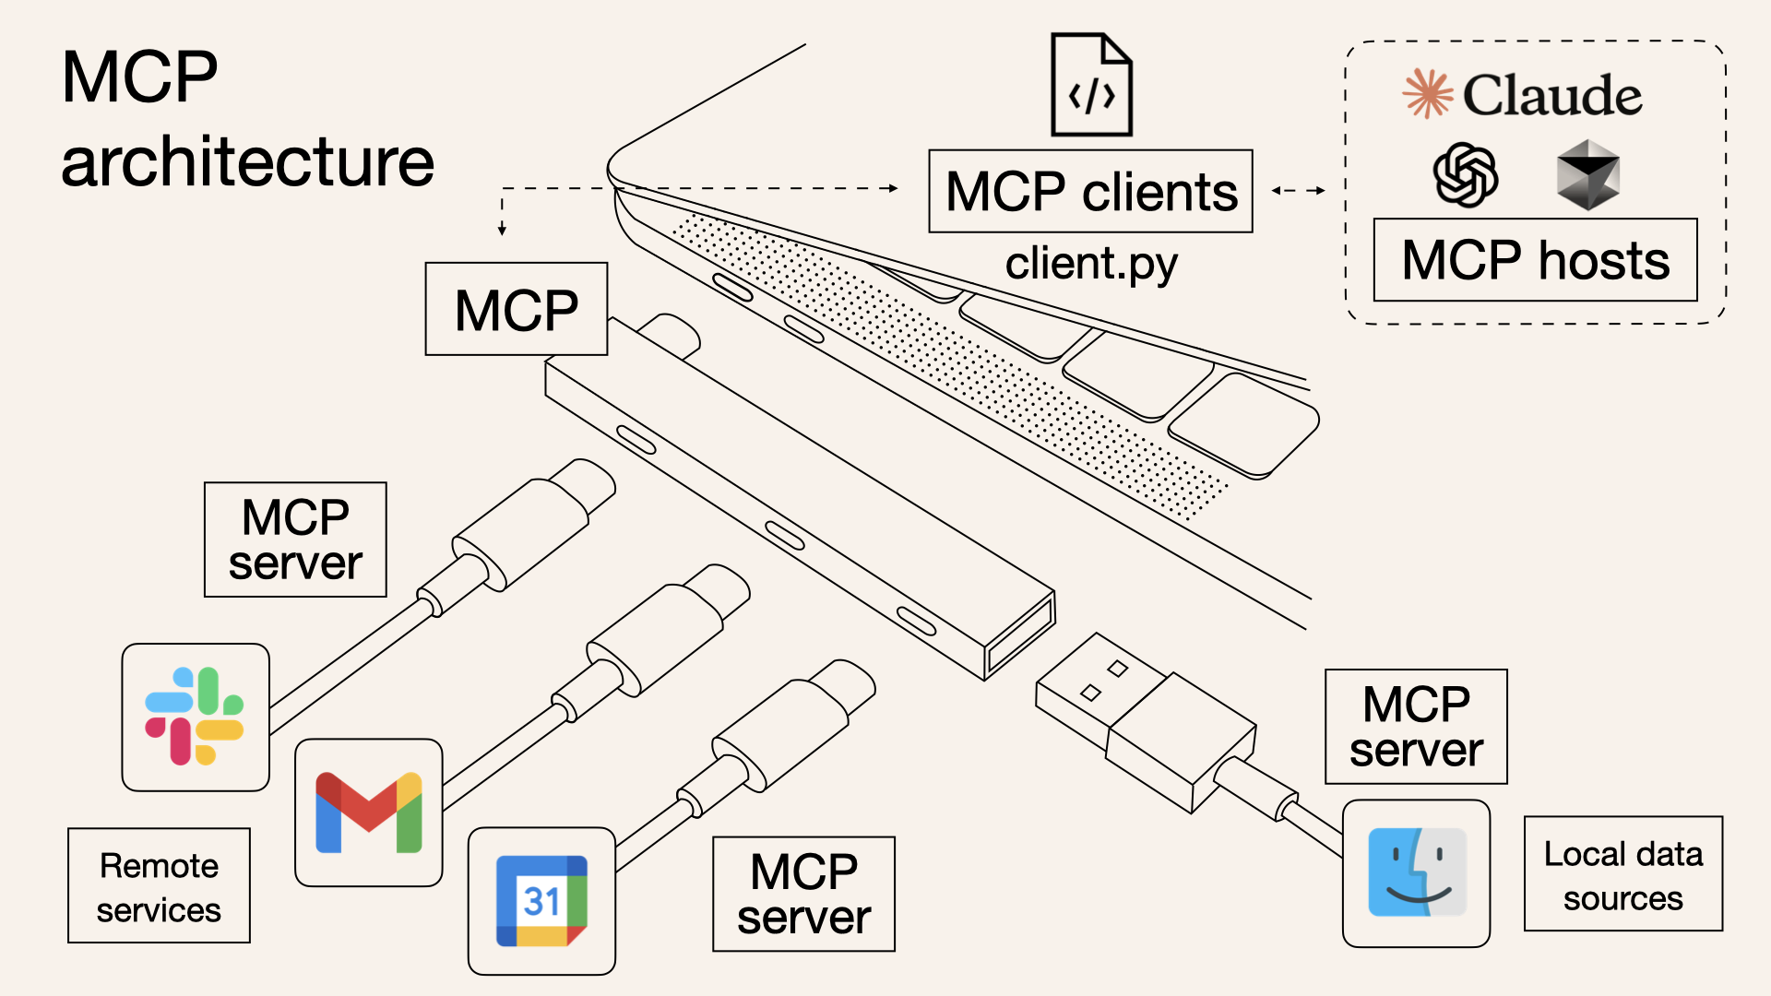
Why MCP is a Game-Changer:
Plug-and-Play Ecosystem
Open Standard
The open standard encourages community-built connectors for
various tools and services.
Focus on Building
Allows developers to reuse integrations (e.g., for PostgreSQL, GitHub)and focus on building the application, not the plumbing.
End of Isolation
Frees LLMs from isolation, enabling real tool use and contextual
answers based on your data.
AI Action
Allows AI to act on your behalf, not just advise – true agent
capabilities.

Slide 18
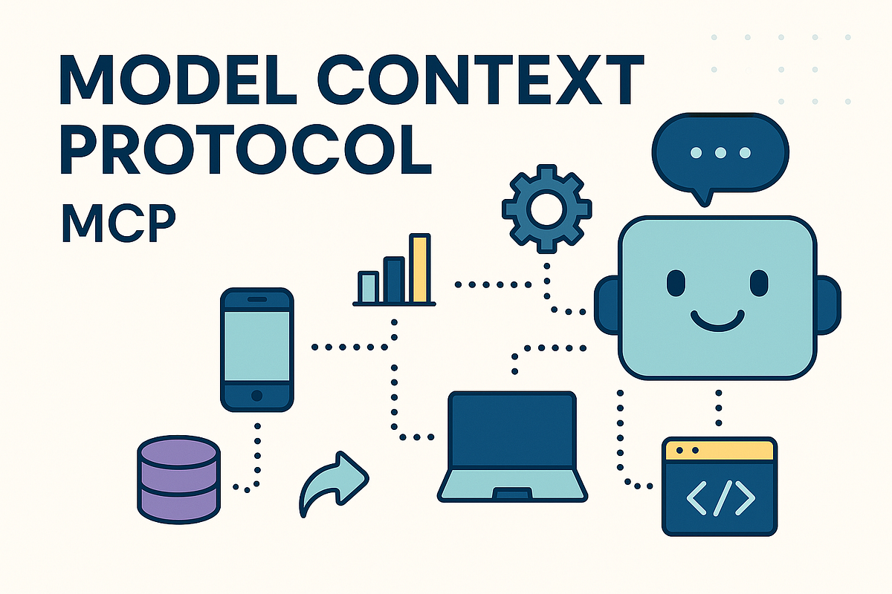
Real-World Example: Database Access
Challenge using APIs
You would typically manually manage connections with each
database and data visualization tool.
MCP Solution
MCP servers for databases (like PostgreSQL and SQLite) enable an AI to perform read-only queries and fetch results.
Rich Context
Instead of supplying a schema in the prompt, the AI can directly
access and query your database.
Code Repositories
MCP servers for Git/GitHub enable your AI to search your codebase,
read files, or even commit changes, transforming AI pair programming.

Slide 19
MCP in Context: Agent-to-Agent Protocols
Understanding the ecosystem of AI communication protocols
Protocol | MCP | A2A (Agent-to-Agent) | ACP
Creator | Anthropic | Google | IBM
Primary Focus | Connects LLMs/agents to external tools, data sources, and APIs. | Facilitates direct communication and collaboration between autonomous agents. | Standardizes structured communication and task coordination among agents in shared environments.
Use Case | Enables dynamic context injection and tool invocation for a single agent or LLM. | Supports multi-agent workflows, task delegation, and coordination. | Enables interoperability and coordination across heterogeneous agent systems.

Slide 20
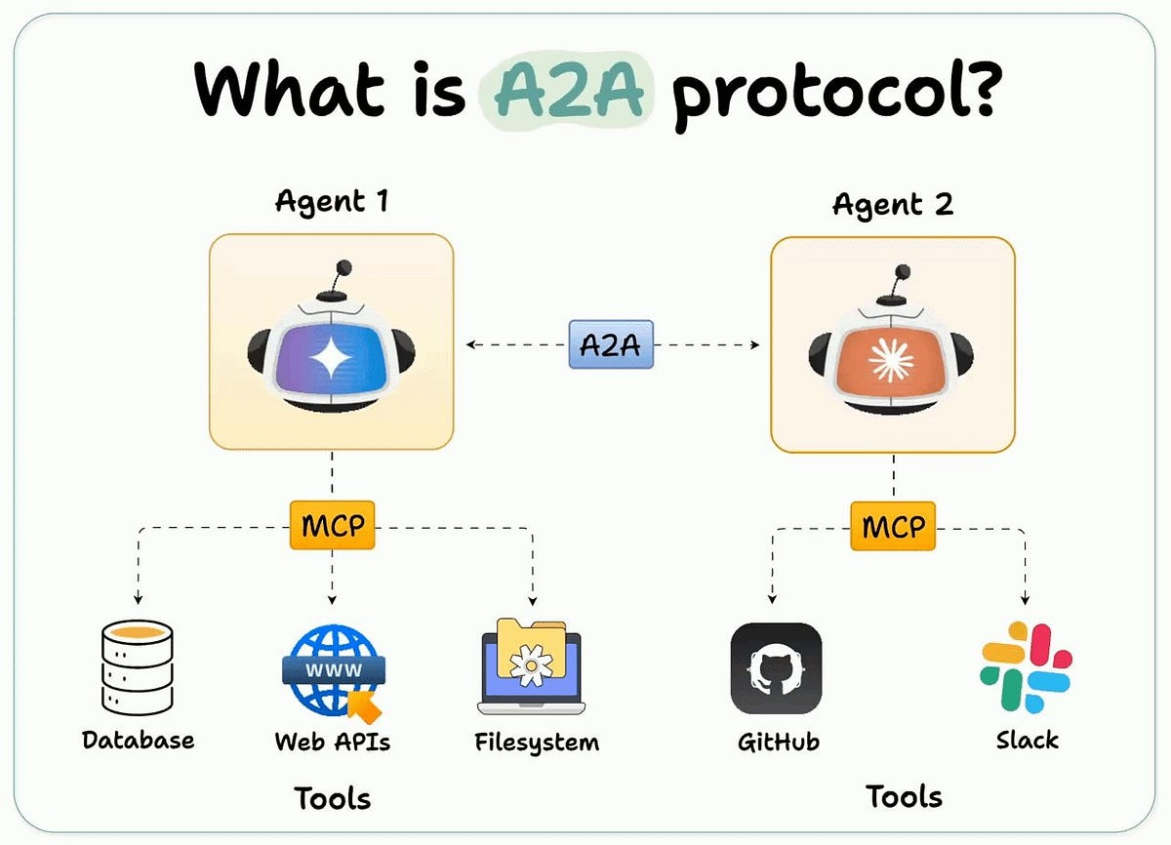
Deep Dive: A2A Protocol
Core Purpose:
An open protocol for secure, interoperable, and structured communication between AI agents. It aims to break down silos between different agent ecosystems.
Discovery:
Agents can advertise their capabilities using an "Agent Card" (JSON format). This helps a client agent find the best remote agent for a task.
Task Management:
Communication is oriented towards task completion. Tasks have a lifecycle and, for long-running processes, agents stay in sync on the latest status. The output is known as an "artifact".
A2A enables multi-agent workflows, task delegation, and coordination across different agent systems.

Slide 21
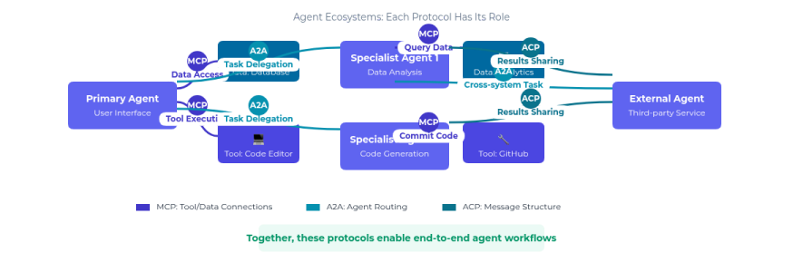
MCP, A2A, and ACP: Complementary Roles
MCP = Execution Backbone
Agents use MCP to fetch data from sources and execute actions via tools. It's the protocol that connects models to the real world.
A2A/ACP = Communication Structure A2A provides the routing logic while ACP provides the message format necessary to build cohesive, intelligent agent ecosystems.
Workflow Integration
Agents first use MCP to gather context and interact with tools, then use A2A to share insights or delegate tasks to other specialized agents.
Cross-Agent Benefits
By using complementary protocols, enterprises can build AI systems that gather information, take actions, and collaborate effectively across specialized agent boundaries.

Slide 22

Getting Started: Integrating MCP
Leverage Existing Servers
Always check official examples; connectors for common tools likely
already exist in the community repositories.
Use MCP-Enabled Clients
Ensure your AI model supports MCP. Tools like Claude Desktop, Cursor IDE, and frameworks like LangChain offer built-in MCP support.
Build Custom Servers
If your data source is proprietary, building a custom server is easy
using SDKs (Python, TypeScript, etc.). Use FastMCP to define tool functions.
Agent Frameworks
LangGraph agents can use tools defined on MCP servers via the
langchain-mcp-adapters library.

Slide 23
Summary: MCP is a Win for Everyone!
For AI Application Developers:
Seamlessly connect your app to any MCP server with zero extra integration effort.
For AI Application Users:
Enjoy rich, extensible AI capabilities across all your tools without compatibility headaches.
For Tool or API Developers:
Build once—deploy everywhere: a single MCP-compliant server that any application can adopt.
For Enterprises:
Enforce clear separation of concerns and governance across AI product teams.
MCP provides the standardization necessary to ensure robust, secure, and flexible interaction between AI models and the complex world of enterprise data and tools.

Slide 24
Q/A

Slide 25
Thanks

